Slide 2
CO226 Database Systems
Project Demonstration
Group Members:
HERATH H.M.M.E.W.L. (E/15/123)
IRFAN M.M.M. (E/15/138)
JALIYAGODA A.J.N.M. (E/15/140)
RISHIKESHAN L. (E/15/307)

Slide 3
When your absence
doesn’t alter your life
then your presence
has no meaning in it.

Slide 4

DATABASE MANAGEMENT SYSTEM FOR STUDENTS
ATTENDANCE

Slide 5

OUTLINE OF THE PROJECT PLAN
We followed the System Development Life Cycle
Project Initialization
Feasibility Analysis
Requirement Collection
Design
Implementation
Testing
Evaluation
Notes:
So we followed the Database System Development Life Cycle. So it has 7 steps.

Slide 6
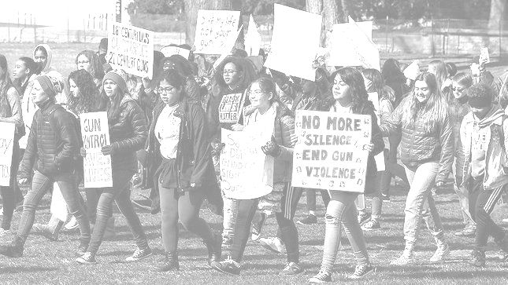
Project Initialization
Paid attention to students problems which may small but can result in BIG issues.
Figure out the issue
In STUDENT ATTENDANCE

Slide 7

PROBLEMS
On Student attendance...
No idea about the current
attendance percentage
Students get notified lately about there
low attendance
Currently, rescheduling process
takes a lot more time

Slide 8

2) Feasibility Analysis
We held Interviews with few Stakeholders of the problem
Students
(from different departments)
Instructors
(Department of Computer Engineering)
Non-Academic Staff
(Department of Computer Engineering)
Notes:
So we took some interviews to gather info to our final product

Slide 9
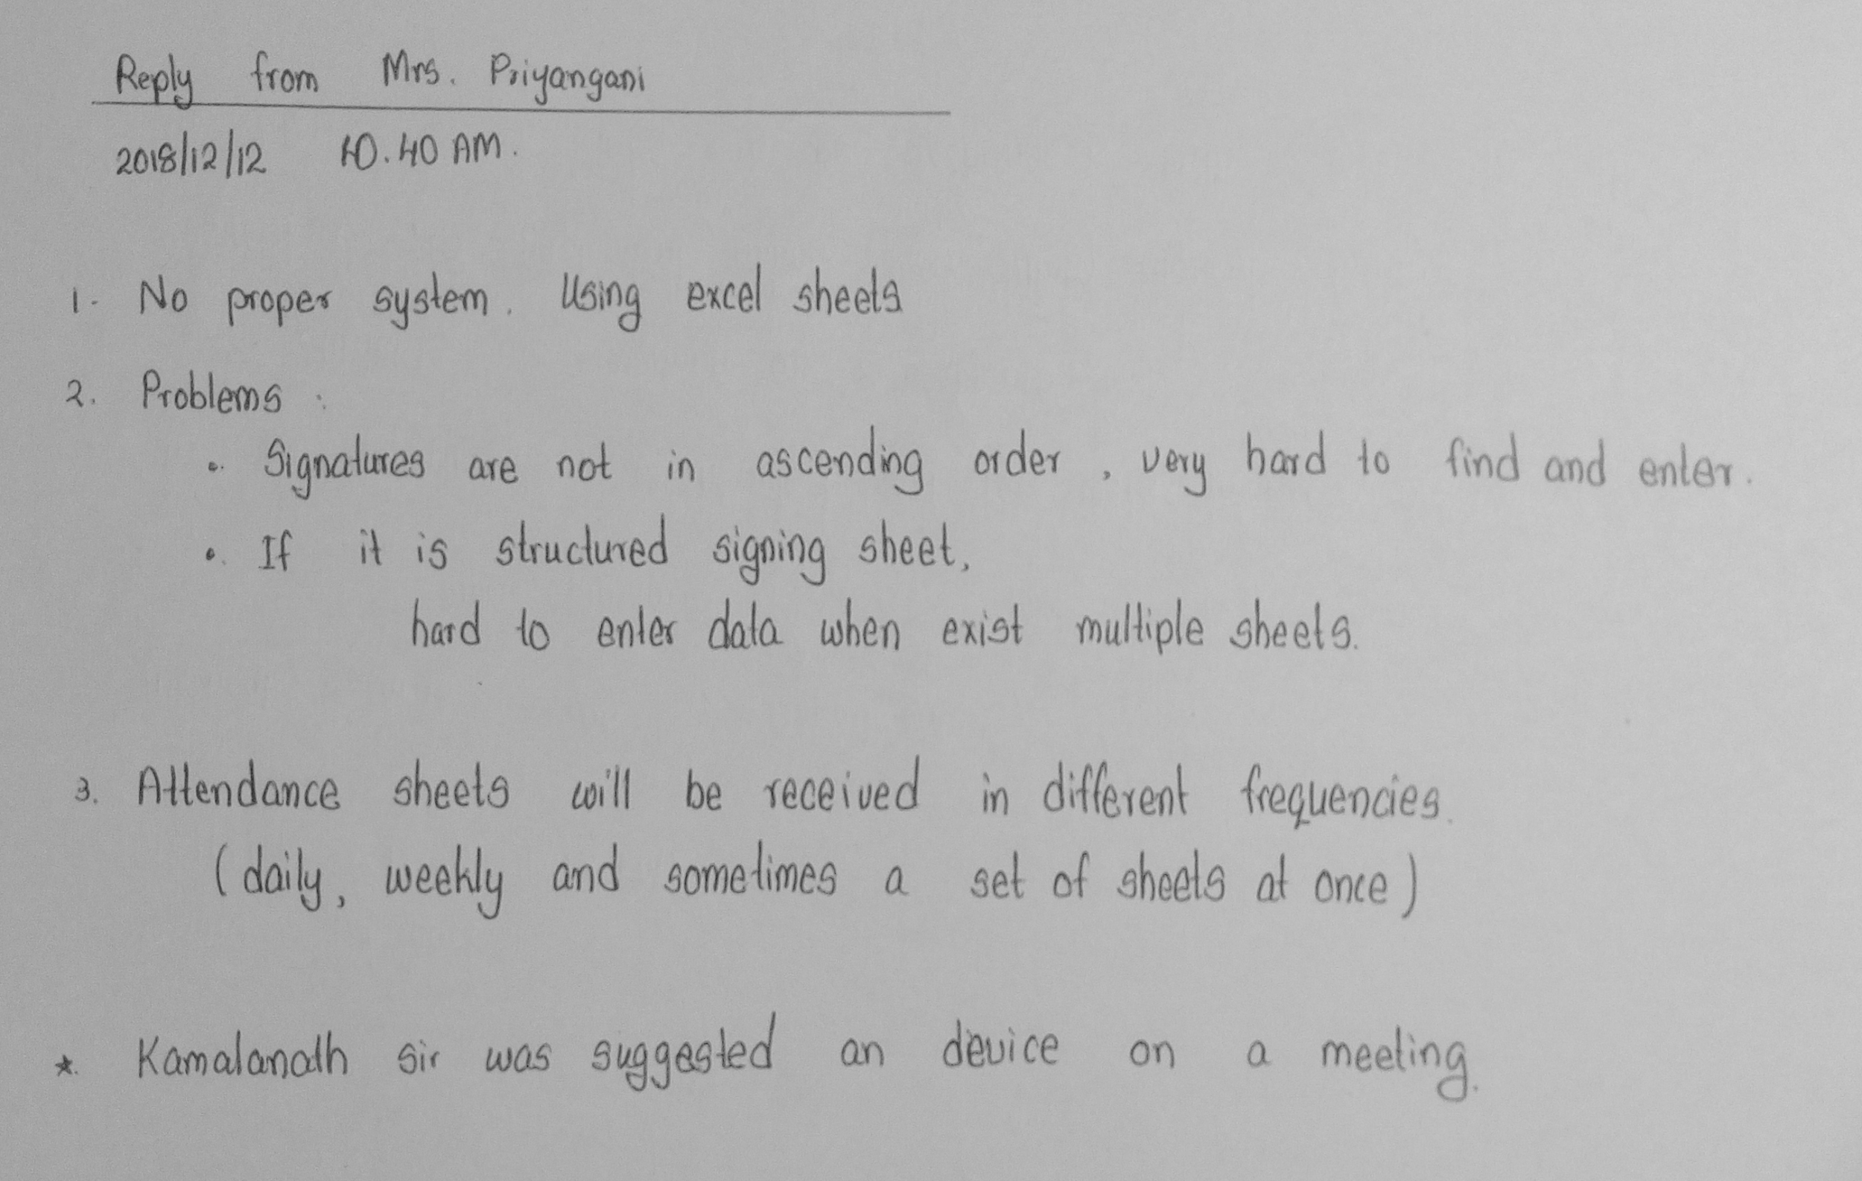
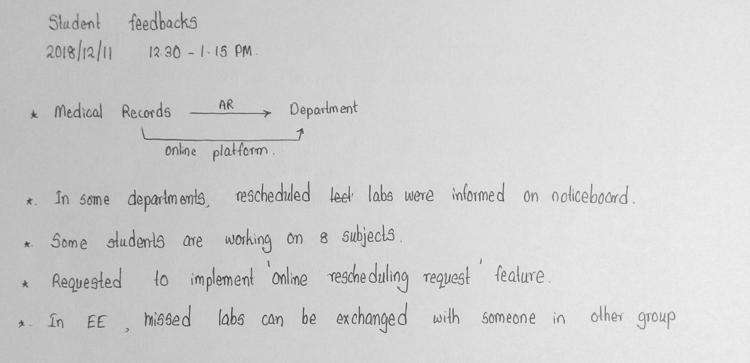
3) Requirement Collection
From interview data, we listed the required features.

Slide 10

Solution!
Created a online
DBMS for the Students Attendance

Slide 11

Targeting Goals
Providing solutions for the problems existing on attendance

Slide 12

Students can see there current attendance percentage whenever they want.
Instructors can mark the attendance data more easily.
MISSION
Reduce the existing problems on attendance which may cause to launch serious actions.
Students can contact instructors and lecturers
directly and more easily.

Slide 13
4) Design
Online Web Portal
Users can login into his/her account
using a password
5 Privilege Levels
Students
Lecturers
Instructors
Data Entry
Administrators

Slide 14

Let’s see how we implemented our design

Slide 15
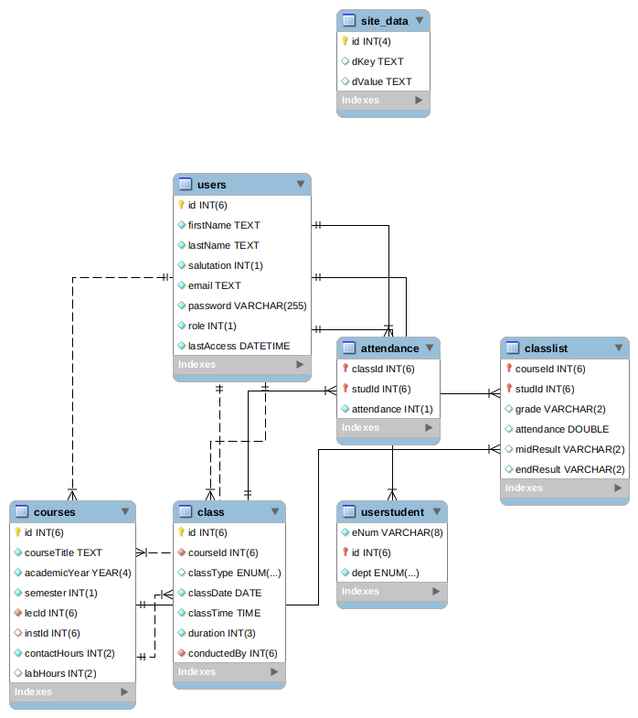

Slide 16
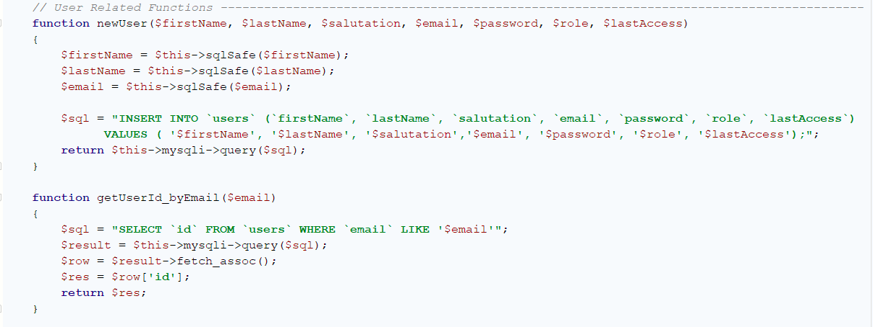

Slide 17
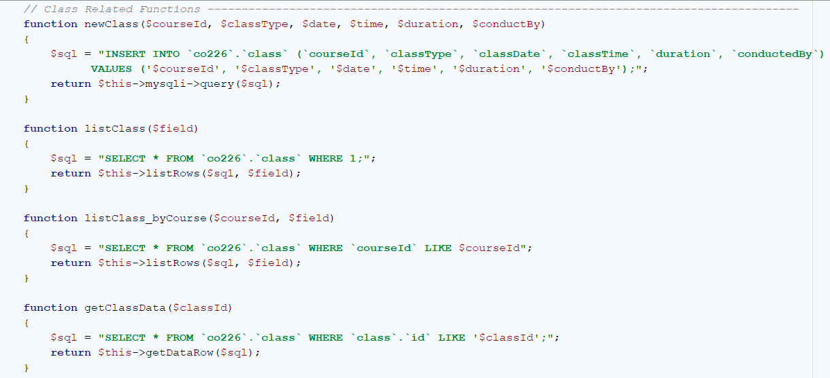
You can visit the site now
https://co224.tk/

Slide 18
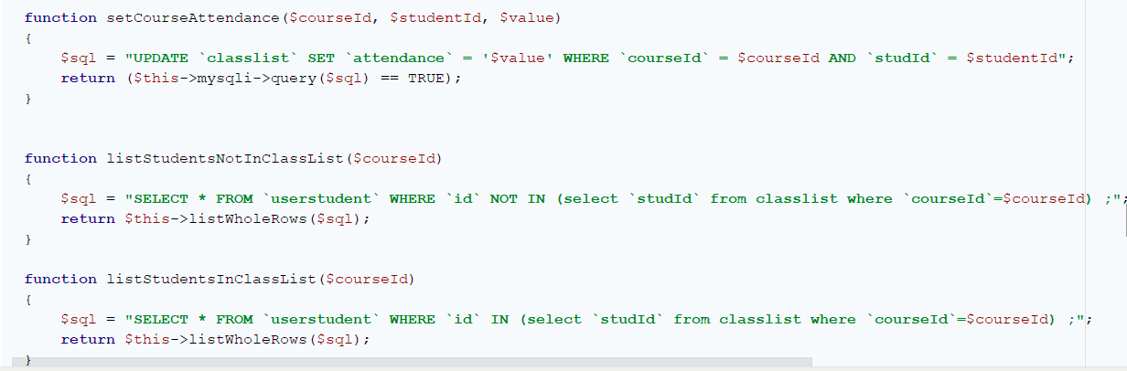
You can visit the site now
https://co224.tk/

Slide 19
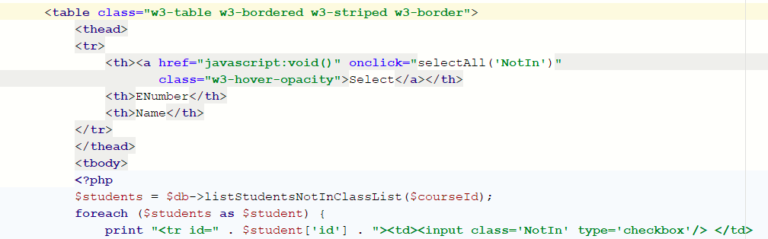
You can visit the site now
https://co224.tk/

Slide 20
You can visit the site now
https://co224.tk/

Slide 21
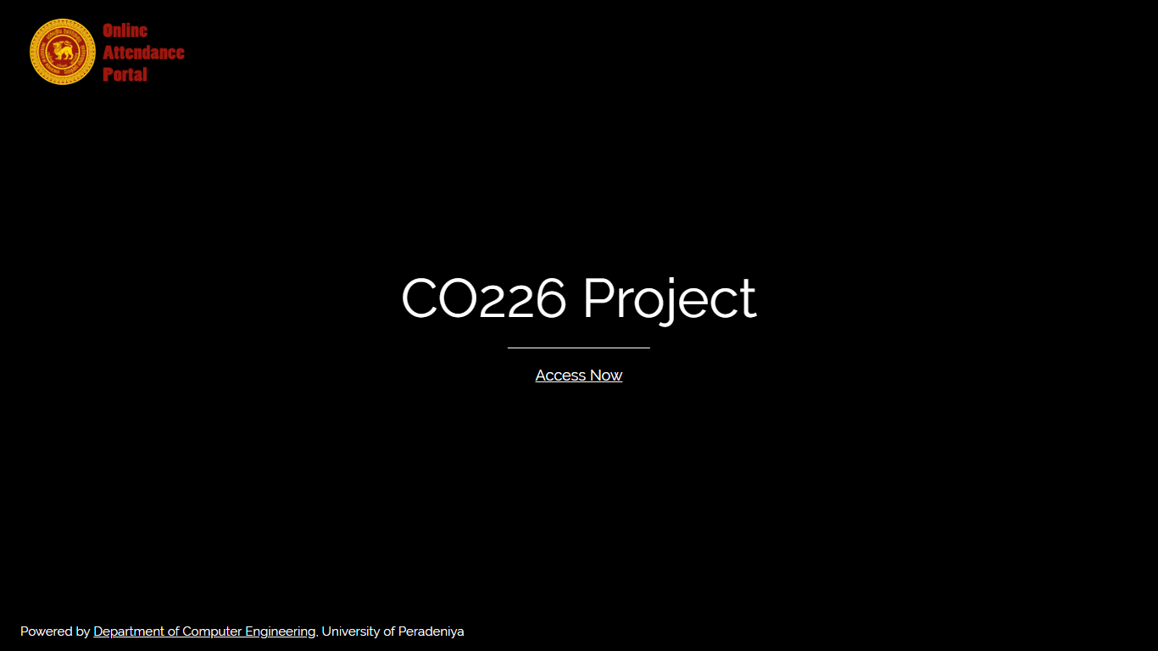

Slide 22
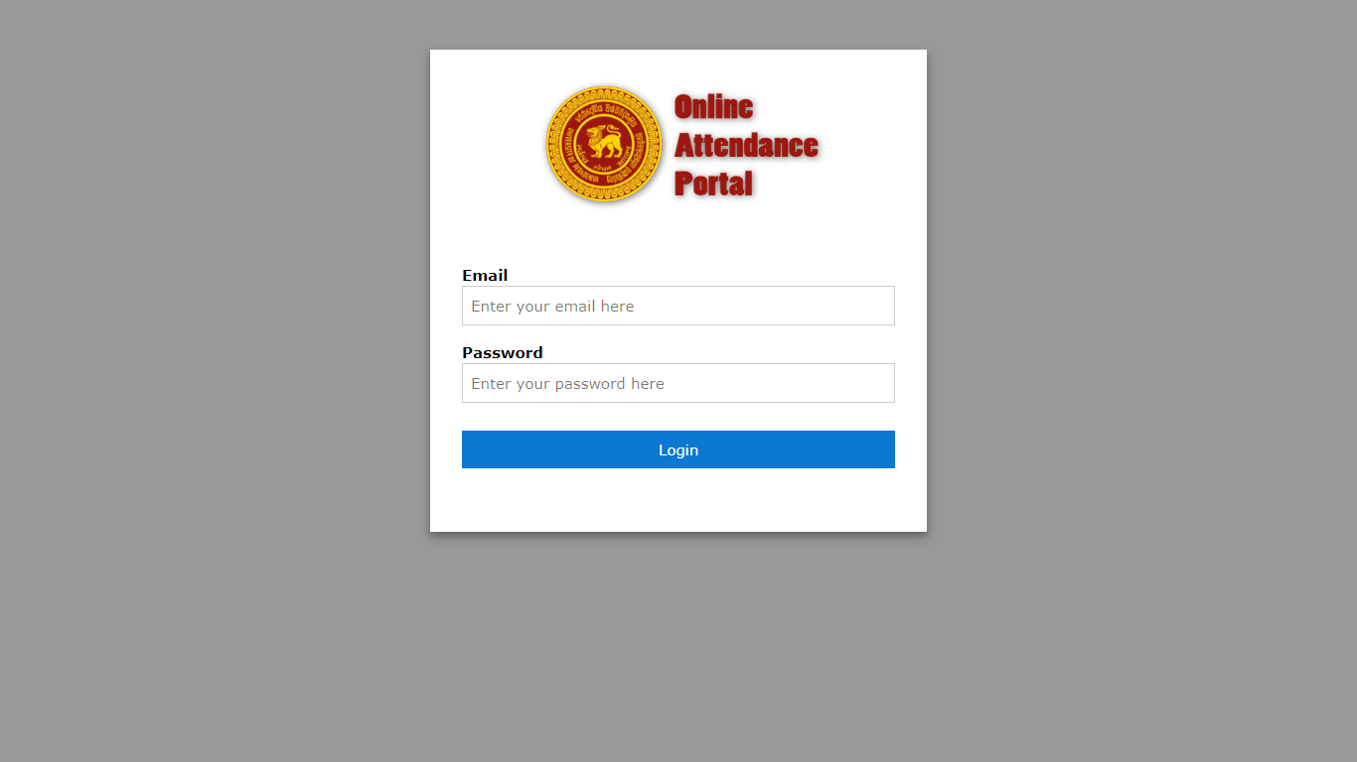
Online Attendance Portal - Faculty of Engineering, University of Peradeniya
Student’s Perspective

Slide 23
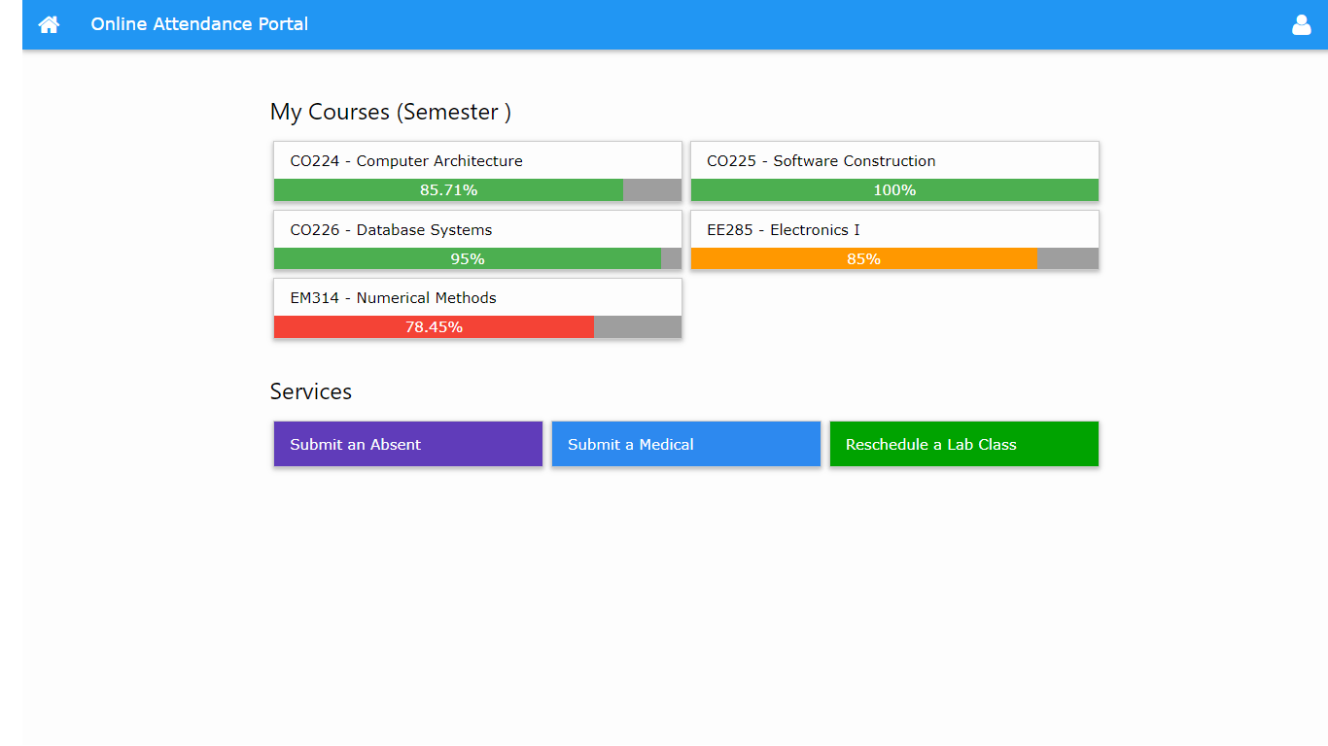
Warning !
Not enough
attendance
percentage
Can inform a reason for an absent
(Ex: Competition, Match, Sick, etc...)
Can request a reschedule for a missed lab class from here.
Can submit a medical for sick from here

Slide 24
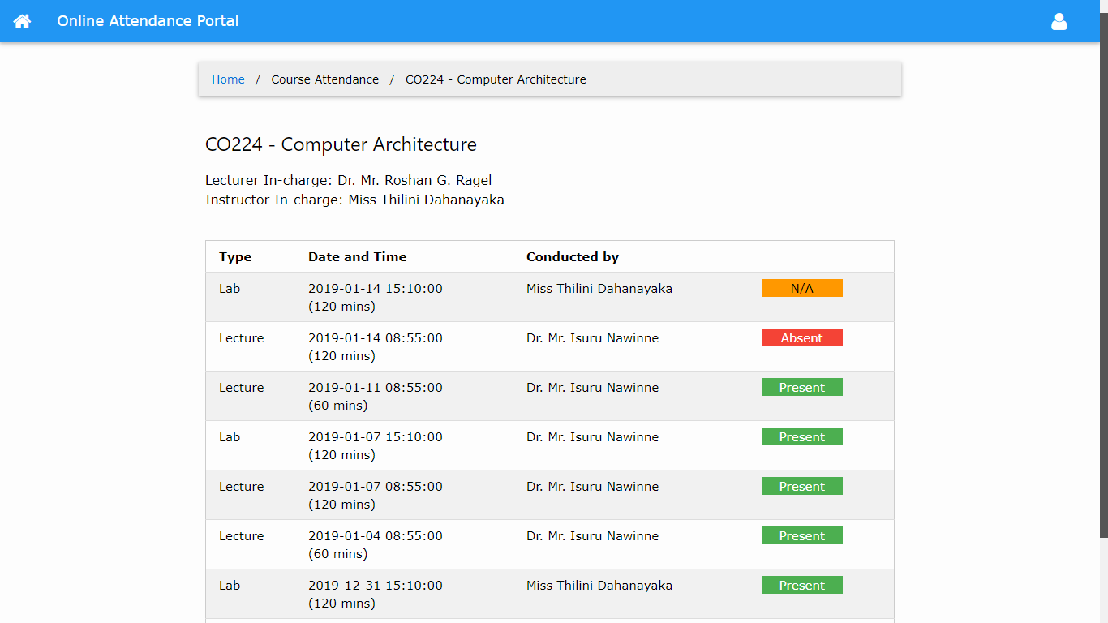

Slide 25
Online Attendance Portal - Faculty of Engineering, University of Peradeniya
Lecturer’s / Instructor’s Perspective

Slide 26
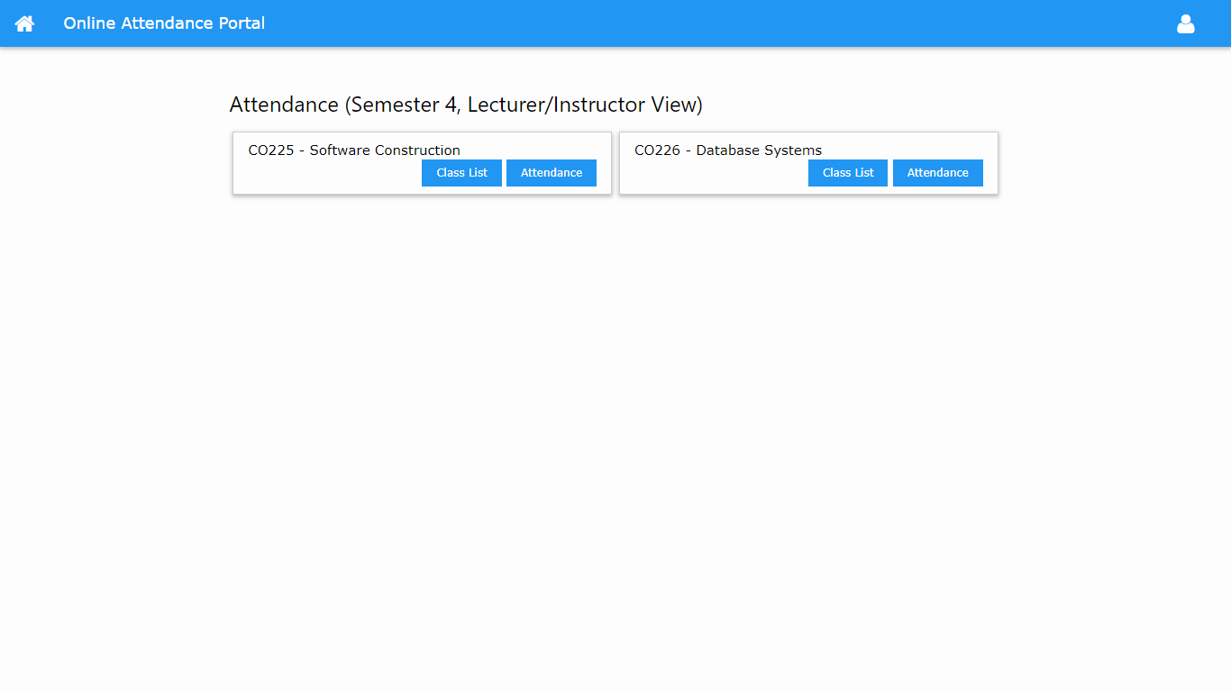

Slide 27
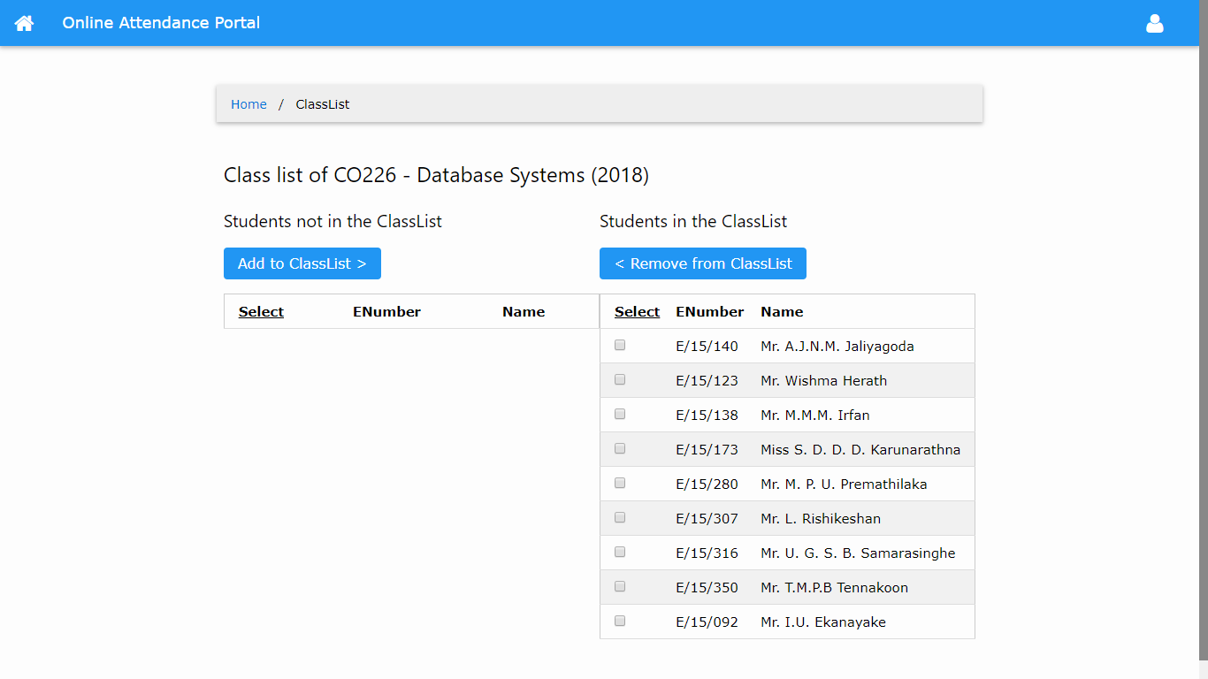

Slide 28
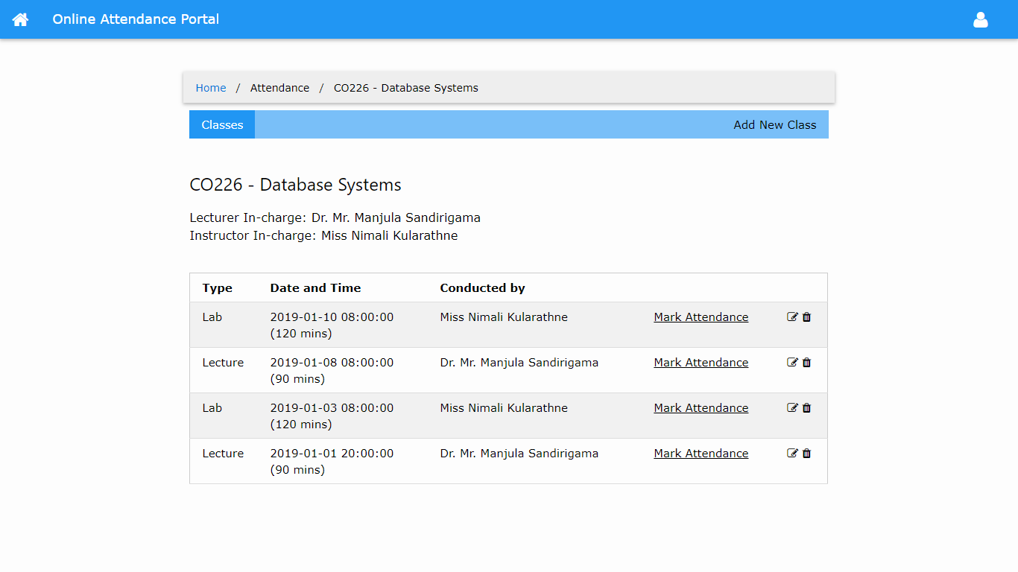

Slide 29
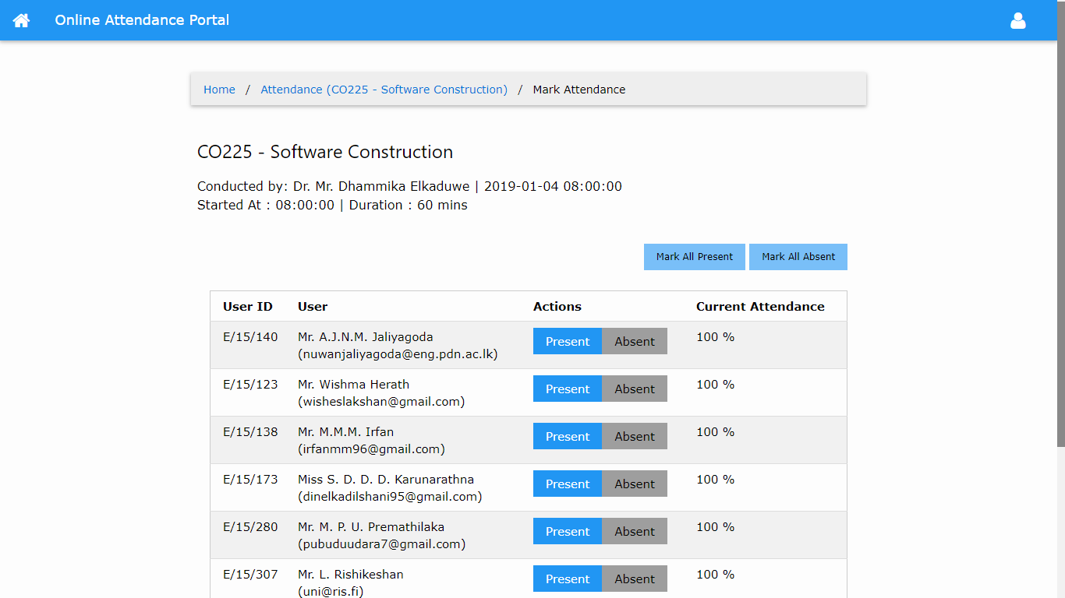

Slide 30
Online Attendance Portal - Faculty of Engineering, University of Peradeniya
Administrator’s Perspective

Slide 31
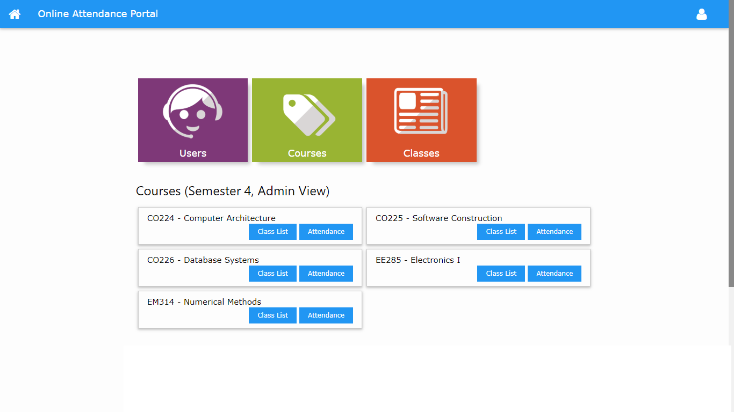

Slide 32
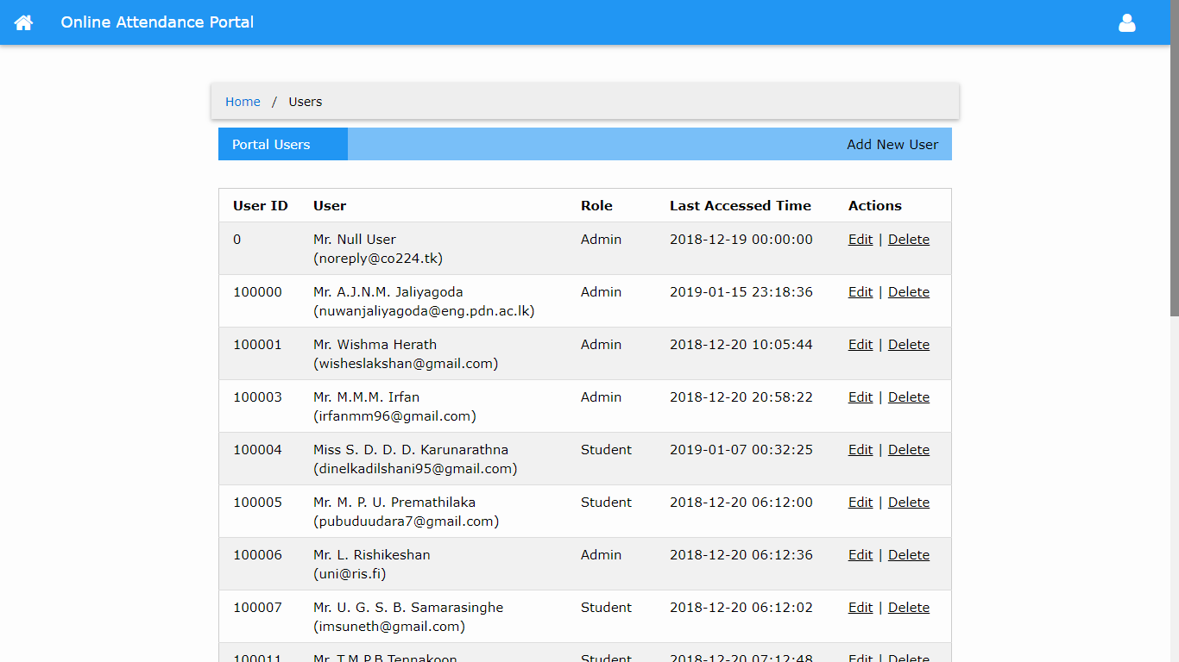

Slide 33
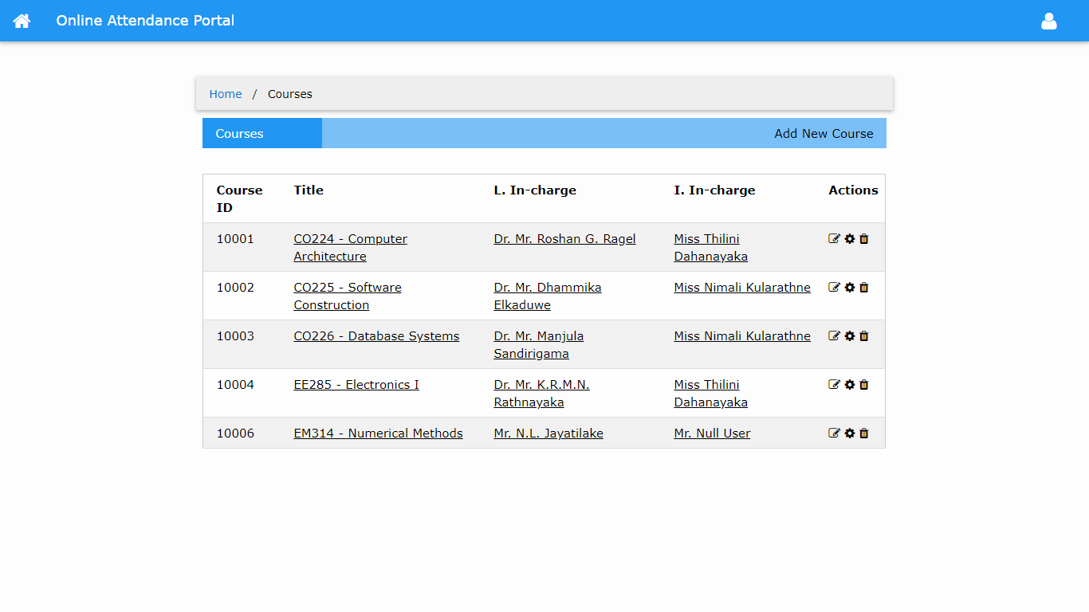

Slide 34
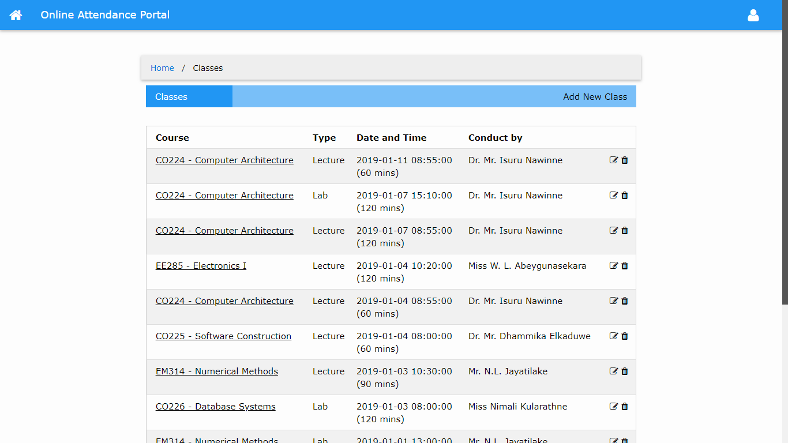

Slide 35





Technologies we used ...

Slide 36
Graphical representation of Time management
5%
Project
initiation
15%
Analysis
20%
Design
45%
Implementation.
15%
Testing &
evaluation
Diagram featured by http://slidemodel.com

Slide 37
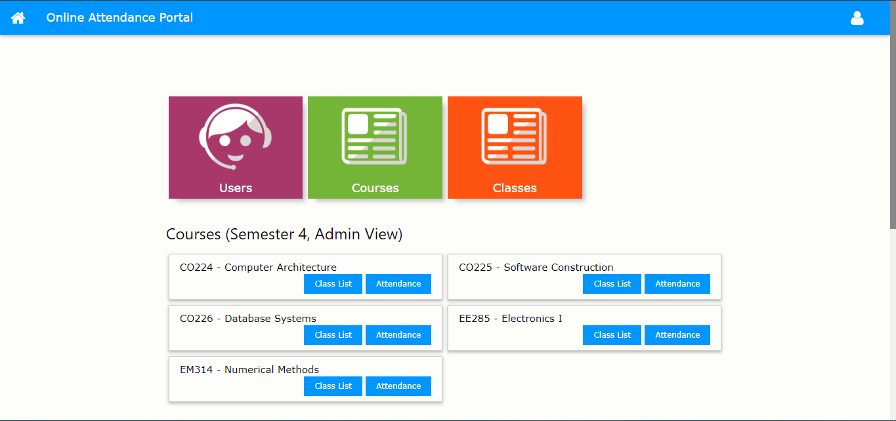
Future Improvements
Improve the security of the database.
Populate the database for all the departments of the faculty.
RFID device to mark attendance
Place your screenshot here

Slide 38
Special Thanks
To all the people who supports us to share their informations…..

Slide 39
Thanks!
Any questions?

